Slide 1

Virtual Currency
Andrew Koenig

Slide 2
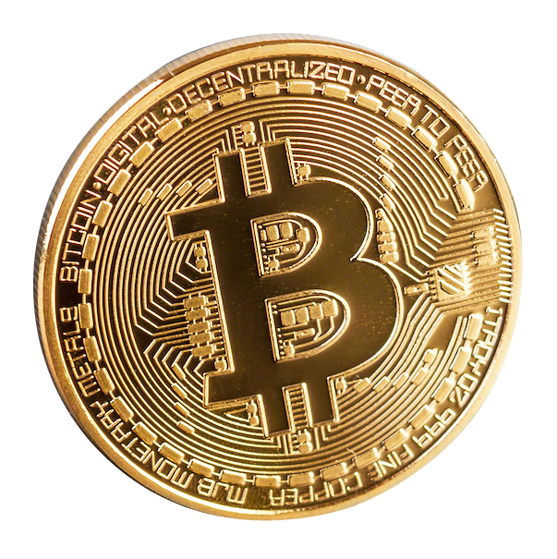
What is it?
Virtual currency (Cryptocurrency) is a type of digital asset that is designed as a medium of exchange. It is different from traditional currency due to being completely digital as well as operating independently of a central bank or government.

Slide 3

How does it work?
Virtual currency works on a digital ledger called a blockchain
Cryptocurrency can be purchased and stored in a wallet, or stored in an exchange
Depending on the price of the currency, the value of the currency stored in a wallet can fluctuate

Slide 4
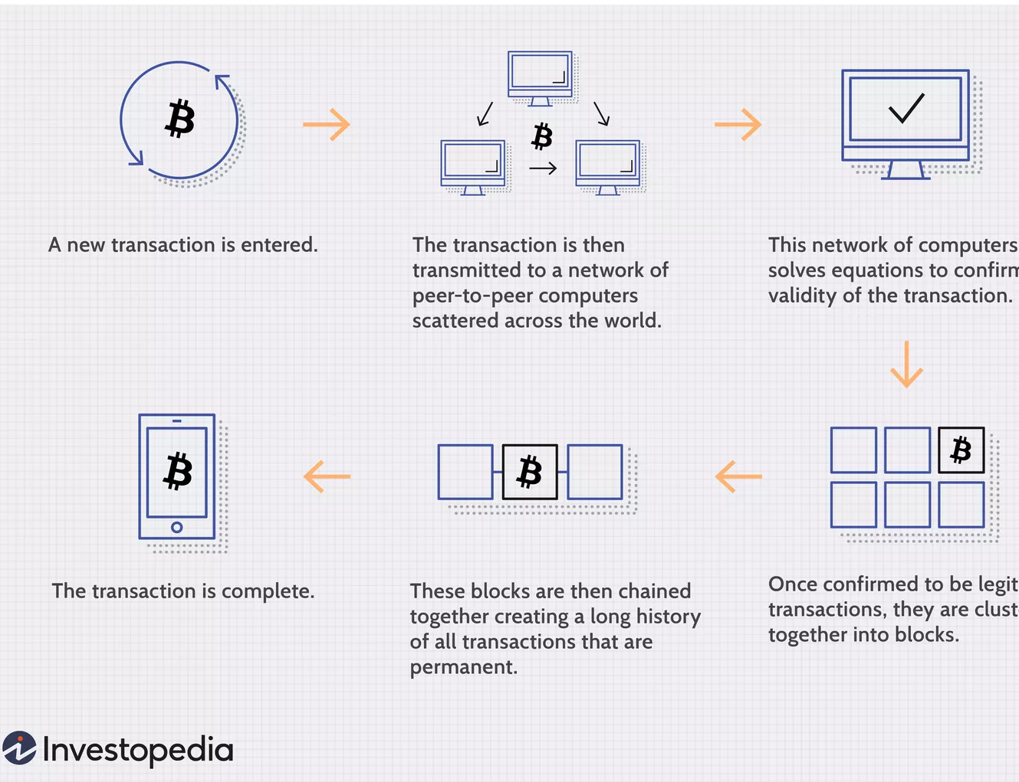
Blockchain Transactions
For currency to be moved it must be validated on the blockchain. This is why crypto transactions can take some time.

Slide 5
Is crypto anonymous?
Virtual currency is not anonymous, but instead is pseudoanonymous
Your identity is not hidden, but you are given a fake one
Your crypto wallet has an address that is separate from your identity

Slide 6

Is it secure?
The use of blockchain makes virtual currency a secure system. Since it is a peer-to-peer system spread out over a network, someone would have to change information on a majority of the systems on the network for them to accept the change. Even then, people would notice and take action.

Slide 7

The bad side
Crypto currency is the main method of payment on the dark web and allows a careful user to be much harder to track compared to using traditional payments.

Slide 8
Conclusion
Virtual currencies are here to stay. New ones pop up every day trying to be the next bitcoin and they show no sign of slowing down.

Slide 9
Citation
Kaspersky. “What Is Cryptocurrency and How Does It Work?” Www.kaspersky.com, 19 Apr. 2023, https://www.kaspersky.com/resource-center/definitions/what-is-cryptocurrency.
O'Sullivan, Fergus. “Is Crypto Anonymous 2023 [Is Bitcoin More Traceable than Cash].” Cloudwards, 23 Mar. 2023, https://www.cloudwards.net/is-crypto-anonymous/.
Frankenfield, Jake. “Cryptocurrency Explained with Pros and Cons for Investment.” Investopedia, Investopedia, 23 Feb. 2023, https://www.investopedia.com/terms/c/cryptocurrency.asp.
“What Is Cryptocurrency? A Guide for Beginners.” NerdWallet, https://www.nerdwallet.com/article/investing/cryptocurrency.
S, Ravikiran A. “What Is Blockchain Technology? How Does Blockchain Work? [Updated].” Simplilearn.com, Simplilearn, 31 Mar. 2023, https://www.simplilearn.com/tutorials/blockchain-tutorial/blockchain-technology.

